Slide 1
CSE 4101
Topic 17: Fuzzy Logic

Slide 2
Introduction
Fuzzy set and crisp set are the part of the distinct set theories, where the fuzzy set implements infinite-valued logic while crisp set employs bi-valued logic. Crisp sets are the sets that we have used most of our life. Crips set represents the binary membership value of element in the set. In a crisp set, an element is either a member of the set or not. For example, a jelly bean belongs in the class of food known as candy.

Slide 3
Introduction
The 'Fuzzy' word means the things that are not clear or are vague. Fuzzy logic is not logic that is fuzzy, but logic that is used to describe fuzziness. Fuzzy logic is the theory of fuzzy sets, sets that calibrate vagueness. Fuzzy logic is based on the idea that all things admit od degrees. Temperature, height, speed, distance, beauty- all come on a sliding scale. For example: “The motor is running really hot”. “Tom is a very tall guy”.

Slide 4
Introduction
Boolean logic uses sharp distinction, It forces us to draw lines between members of a class and non-members. For instance, we may say, Tom is tall because his height is 181 cm. If we draw a line at 180 cm, we would find that David, who is 179 cm, is small.
Fuzzy logic reflects how people think. It attempts to model our sense of words, our decision making and our common senses. As a result, it is leading to new, more human, intelligent system.

Slide 5
Introduction
In 1965, Lotfi Zadeh, published his famous paper “Fuzzy sets”. Zadeh extended the work on possibility theory into a formal system of mathematical logic, and introduced a new concept for applying natural language terms. This new logic for representing and manipulating fuzzy terms was called fuzzy logic, and Zadeh became the Master of Fuzzy logic.

Slide 6
Fuzzy Logic
Fuzzy logic is a set of mathematical principles for knowledge representation-based degree of membership. Unlike two-valued Boolean logic, fuzzy logic is multi valued. Fuzzy logic uses the continuum (Range) of logical values between 0 (completely false) and 1 (Completely true). For example, instead of black and white, it employs the spectrum of colors, accepting that things that things that can be partly true and partly false at the same time.

Slide 7
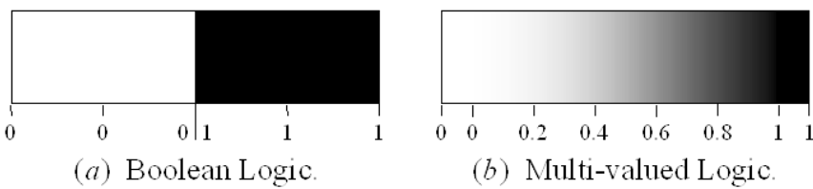
Fuzzy Logic
To practically compare between fuzzy logic and Boolean logic let us answer to the question “Is it cold?” The answer can be simple yes or no or it can vary significantly between yes and no like not so cold, cold enough, moderate cold, cold, very cold etc.

Slide 8
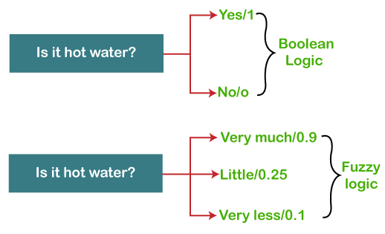
Comparison Between Fuzzy Logic and Boolean Logic

Slide 9
Comparison Between Fuzzy Logic and Boolean Logic
Boolean logic only works with two values 0 and 1. But using fuzzy logic helps us to represent the values between 0 and 1 like degree of something. In the above example, the answer to the question “Is it cold ?” can be simple yes or no or it can varies significantly between yes and no like not so cold, cold enough, moderate cold, cold, very cold etc.. For the first case, Boolean logic suffice. But for the latter case, Boolean logic will fail. That’s where Fuzzy logic comes into play.

Slide 10
Comparison Between Fuzzy Logic and Boolean Logic
Fuzzy logic will tell us how much the coldness or another way, the degree of coldness. Referring to the figure if the weather is “very much” cold, then fuzzy logic will say “The weather is cold up to degree 0.9”. For the “little” cold case, the degree of coldness is 0.25 and for the “very less” case, the degree of coldness is 0.1
Caution: Fuzzy logic value must be in the range [0-1]. The value can’t go outside this closed interval.

Slide 11
Fuzzy Set
The basic idea of the fuzzy set theory is that an element belongs to a fuzzy set with a certain degree of membership. The membership degree quantifies the grade of membership of the element. to the fuzzy set. The value 0 means that is not a member of the fuzzy set; the value 1 means that. is fully a member of the fuzzy set. The values between 0 and 1 characterize fuzzy members, which belong to the fuzzy set only partially.

Slide 12
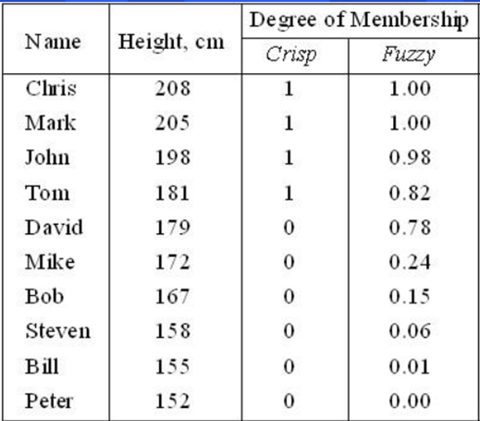
Fuzzy Set
One classical example in fuzzy sets is tall men. The elements of the fuzzy set “tall men” are all men, but their degree of membership depend on their height.

Slide 13
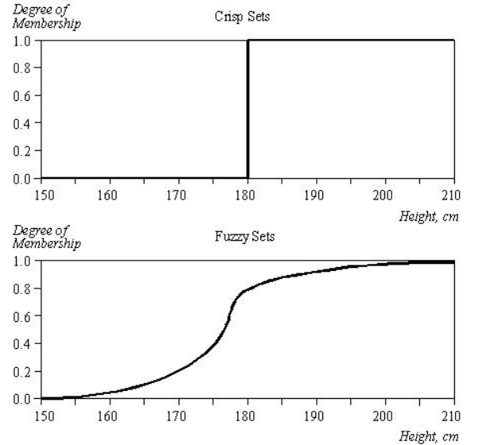
Fuzzy Set
The x-axis represents the universe of discourse- the range of all possible values applicable to a chosen variable. In this case, the variable is the man height. The y-axis represents the membership value of the fuzzy set.

Slide 14
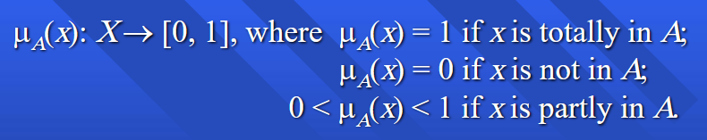
Fuzzy Set
Let X be the universe of is discourse and its element be denoted as X. In the fuzzy theory, fuzzy set A of universe X is defined by a function μ_A (X) called the membership function of set A.

Slide 15
Membership Function
The membership function is used to estimate or compute the degree of membership of a certain input element in a specific fuzzy set. The Universe is on the x-axis, while the degrees of membership are on the y-axis. The value 0 means that element is not a member of the fuzzy set; the value 1 means that the element is fully a member of the fuzzy set. The values between 0 and 1 characterize fuzzy members, which belong to the fuzzy set only partially.

Slide 16

Membership Function
The universe of discourse-the men’s heights-consists of three sets: short, average and tall men. It can be observed that a man who is 184 cm tall is a member of the average men set with a degree of membership of 0.1, and at the same time, he is also a member of tall men with a degree of membership of 0.4.
The membership function μA forms the basis of fuzzy set and is denoted as,

Slide 17
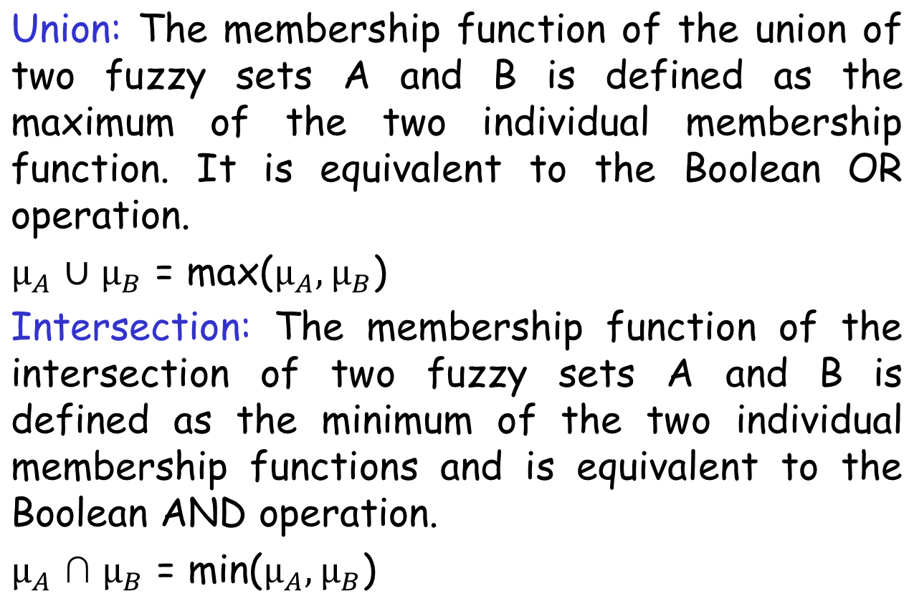
Fuzzy Operation

Slide 18
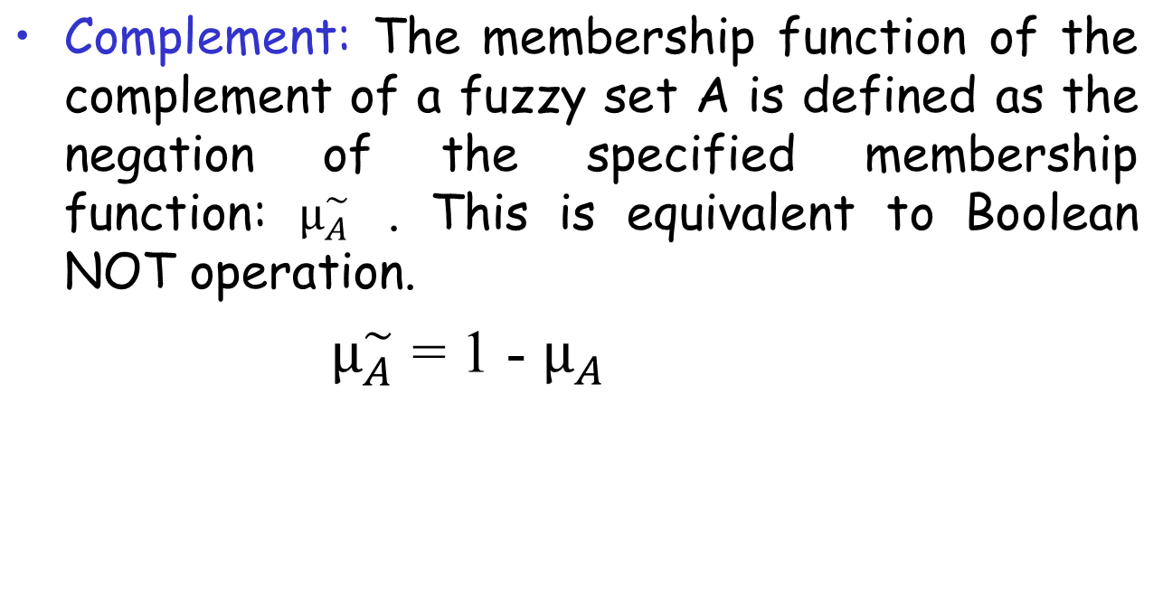
Fuzzy Operation

Slide 19
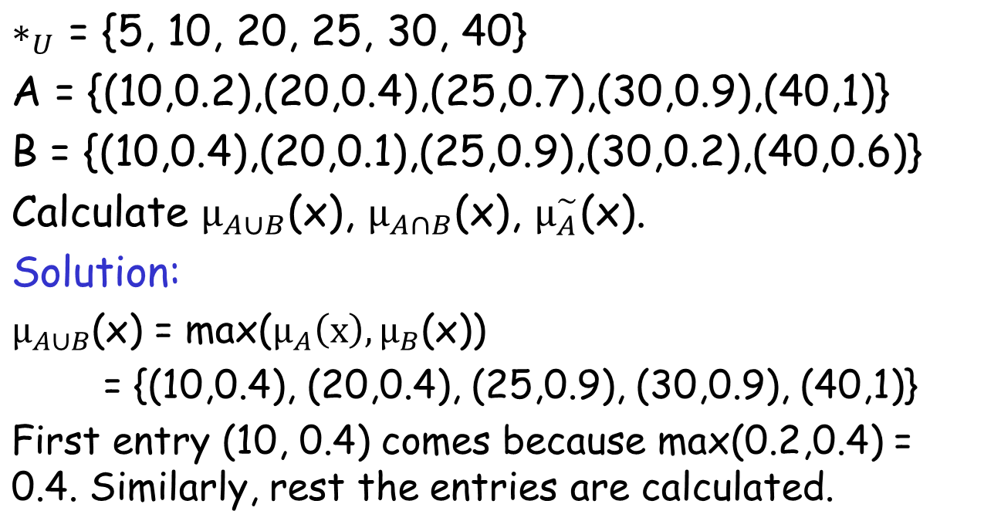
Fuzzy Operation(Math)

Slide 20
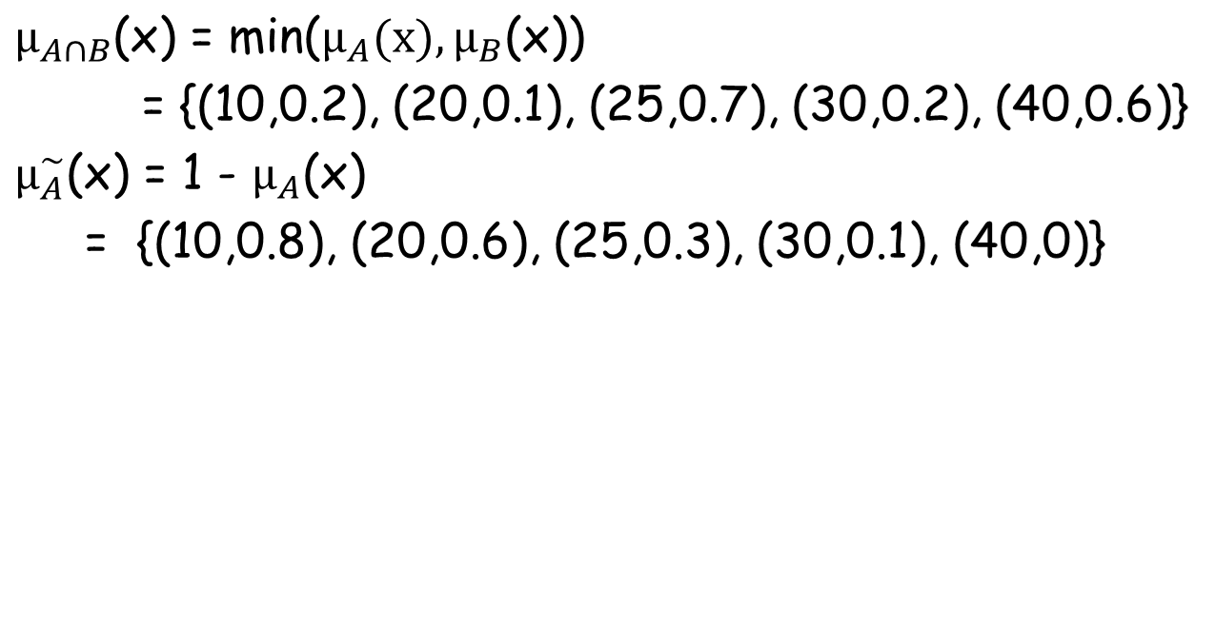
Fuzzy Operation(Math)

Slide 21
Linguistic Variable and Hedges
At the root of fuzzy set theory lies the idea of linguistic variables.
A linguistic variable is a fuzzy variable. For exempla, the statement “John is tall:” implies that the linguistic variable John takes the linguistic value tall.

Slide 22
Linguistic Variable and Hedges
In fuzzy expert systems, linguistic variable are used in fuzzy rules. For example:
IF wind is strong
THEN sailing is good
IF project_duration is long
THEN completion_risk is high
IF speed is slow
THEN stopping_distance is short

Slide 23
Linguistic Variable and Hedges
The ranges of possible values of a linguistic variable represents the universe of discourse of that variable. For example, the universe of discourse of the linguistic variable speed might have the range between 0 and 220 km/h and may include such subsets as very slow, medium, fast and very fast.
A linguistic variable carries with it the concept of fuzzy set qualifiers, called hedges.
Hedged are terms, that modify the shape of fuzzy sets.
They include adverb, such as very, somewhat, quite, more or less and slightly.

Slide 24
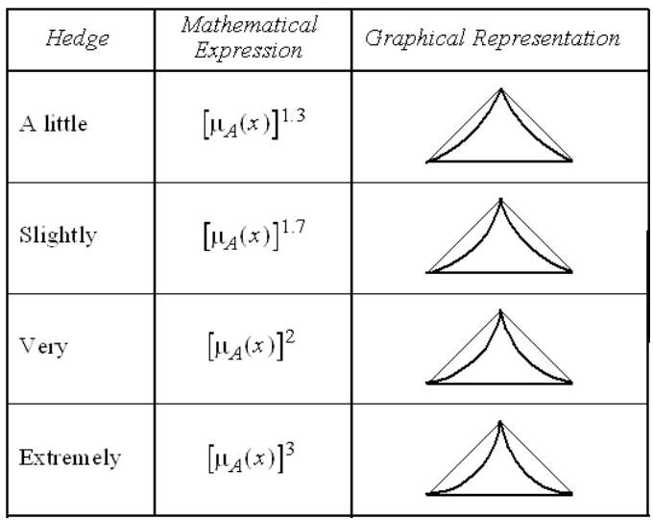
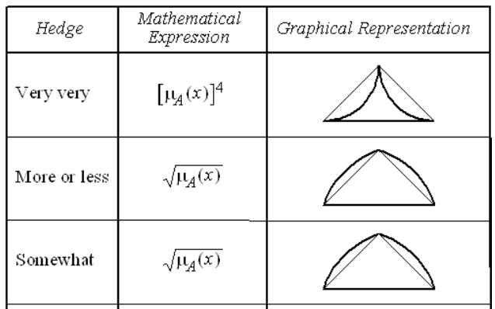
Linguistic Variable and Hedges

Slide 25
Linguistic Variable and Hedges
Example:
A real-world situation is defined by a fuzzy set as follows:
A= {0.0, 10.0}, {0.2, 11.0}, {0.4, 12.0}, {0.6, 13.0}, {0.8, 14.0}, {1.0, 15.0})
Hence VERY OF (A)= [μA (x)]^2= {{(0.0)2, 10.0}, {{0.2}2, 11.0}, {(0.4)2, 12.0}, {{0.6}2, 13.0}, {{0.8}2, 14.0}, {{1.0}2, 15.0})
= {{0.0, 10.0}, {0.4, 11.0}, {0.16, 12.0}, {0.36, 13.0}, {0.64, 14.0}, {1.0, 15.0})

Slide 26
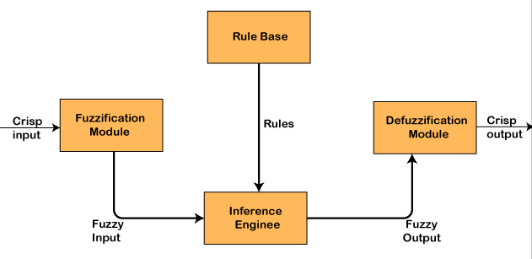
Architecture of Fuzzy Logic System

Slide 27
Architecture of Fuzzy Logic System
Fuzzy logic system consists of four main parts:
Fuzzifier (Fuzzification): A crisp set of input data are gathered and converted to a fuzzy set using linguistic variable, fuzzy linguistic terms and membership function. This is known as fuzzification.
Rule Base: It contains all the rules and the if-then conditions offered by the experts to control the decision-making system.

Slide 28
Architecture of Fuzzy Logic System
Inference engine: It helps to determine the degree of match between fuzzy input and the rules. Based on the % match, it determines which rule need to implement according to the given input field. After this the applied rules are combined to develop the control action.
Defuzzifier (Defuzzification): At last the defuzzification process is performed to convert the output of fuzzy inference Engine into crisp output

Slide 29
End

